Slide 1
Consulting Frameworks
De-mystifying the Ordeal of the Case Interview
Bill Blackwell
JGSM Consulting Club
November 6, 2001

Slide 2
Agenda
What is a case interview?
How should I manage a case interview?
What are some frameworks that I can use in a case interview?
How should I determine what competitive response is appropriate?

Slide 3
What is a Case Interview?
Case interviews are built around a “problem”
  The first task will be to find the problem
  The second task will be to develop a solution
The format can be either a full or mini case
  Full cases last between 45 minutes to over an hour
  Mini-cases are typically less than 15 minutes
The goals of the case and the depth of analysis depend on the format
All case interviews are designed to test your ability to solve problems in a structured fashion.

Slide 4
Why do Companies use Cases?
Case interviews provide a way to evaluate a person’s reasoning skills in a time-effective manner
  The focus of a case interview is analysis under time pressure – can you solve a problem “under the gun”
  A candidate can demonstrate an incredible depth of knowledge in a very short time based upon his or her analysis
Cases provide an opportunity to give the candidate the “elevator test”
Case interviews give an indication to the candidate’s ability to pass the DTW test
Case interviews are used mostly because everybody else uses them!

Slide 5
Where do Cases Come From?
Cases are typically problems the consultant has worked on and/or finds interesting
  “You’ve just been called into the CEO’s office of a mid-size manufacturer of steel pipe in Pittsburgh…”
  “Phil Condit calls you on the phone and would like your opinion about a new plane Boeing is considering building…”
Cases may be “disguised” much like many business school cases
Cases can also be made-up, on the spot, off your resume!!
Cases are not meant to test your knowledge of an industry !

Slide 6
Manage the Interview
First and foremost, relax!!
  Case interviews test poise and composure as well as “horsepower”
  Would you pass the senior executive test?
Take notes!
  Keep track of where you are and where you are going
  Keep a record so that you have something with which to practice
Keep track of time!
  You have a limited timeframe and must use it to your advantage
  Use dead time to your advantage – silence is not the enemy

Slide 7
Manage the Interviewer
Do not be afraid to ask questions
  The “set-up” will rarely give you enough information to even begin to analyze the case
  Ask reasoned, structured questions that benefit your analysis – do not ask for “basic” data
  Make your assumptions reasonable and explicit – tell your interviewer what you are assuming, why you are assuming it and ask if it is reasonable
Use your notes interactively
  Interviewers judge what you write as well as what you say
  A diagram can save you a tremendous amount of time
The questions you ask are as important as the answers you give – they are an insight into your analytical process

Slide 8
Frameworks Drive Analysis
Frameworks provide a ready-made structure
  Knowing these frameworks thoroughly gives you a baseline from where you can start any analysis
  Applying basic frameworks buys you time to sort your way through a complex case
Interviewers are already familiar with most frameworks
  Most frameworks are well-known because they are useful in “real life” – interviewers will use them on a daily basis
  Creating your own framework can be incredibly effective – but only if the framework itself is incredibly effective
The surest way to get dinged during a case interview is to shotgun your analysis

Slide 9
Types of Frameworks
Economic frameworks
  Supply & Demand
  Profitability
  Cost Structure: Variable Costs, Fixed Costs, Marginal Costs (& Marginal Revenue)
  Operating Leverage
  Elasticity
Industry-level frameworks
  3-Cs
  Value Chain/Supply Chain
  Porter’s Five Forces
  Porter’s Generic Strategies

Slide 10
Types of Frameworks (cont’d)
Firm-level frameworks
  Growth-Share Matrix
  Marketing Frameworks: STP, 4-Ps, 5-Ms
  Core Competencies
  SWOT
  Stakeholder Analysis
Other frameworks
  Organizational Models
  Political Strategy
  Macroeconomics
  Matrices

Slide 11
Economic Frameworks
80% of all consulting cases will deal with basic economics in some fashion
  Supply & Demand
  Profitability
  Demand Elasticity
Basic economic principles also underpin many other frameworks
  Porter’s Five Forces looks a lot like the parameters for a demand curve
  3-Cs, 4-Ps, Value Chain, etc. are all based on one or more economic relationships

Slide 12

Supply & Demand
Consumer Surplus
Producer Surplus
The market-clearing price and quantity is determined by the intersection of demand curve and the supply curve
Surpluses are determined by how much consumers and producers would have paid/charged versus what the market price

Slide 13
Profitability
Profits are defined as total revenue minus total cost
Changes in revenue are due to a change in quantity, price or both
Total cost is the sum of variable plus fixed costs
  Variable costs vary directly with quantity
  Fixed costs are set for a given period
If a firm has become unprofitable, try to determine what has happened to price, quantity and costs!

Slide 14
Cost Structure
Fixed costs are costs that must be incurred regardless of production level
  Lease payments
  Advertising
  Salaries (?)
Variable costs vary directly with quantity sold
  Typically, variable costs are driven by direct labor and direct materials costs
  Depreciation is not part of economic variable cost
Marginal cost is the cost of producing one more unit
  It is the derivative of the variable cost equation
  The supply curve is the aggregation of the marginal cost curves of all market-participating firms

Slide 15
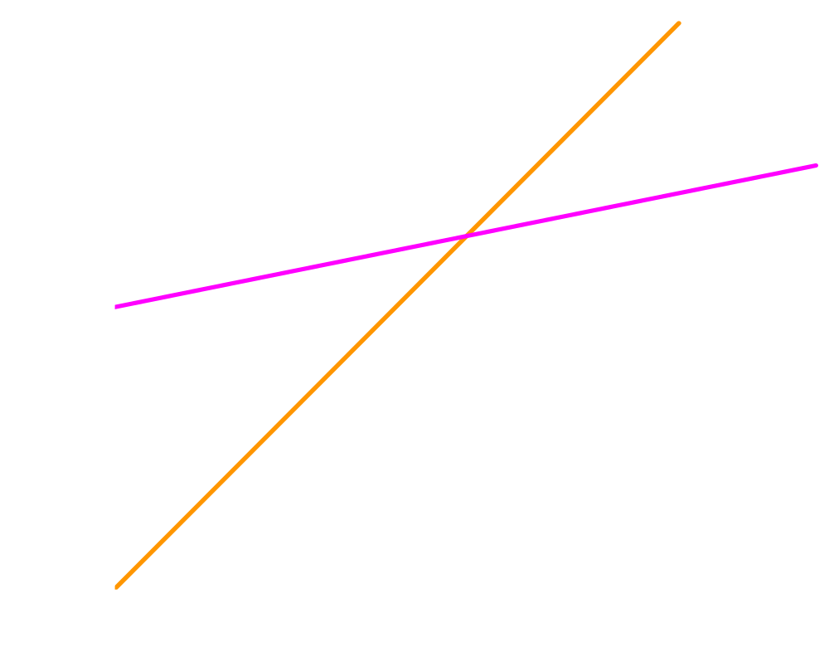
Operating Leverage
Operating leverage is the ratio of fixed costs versus variable costs
Firms with high operating leverage tend to be in industries that require massive economies of scale
  Operating leverage is a form of risk
  High operating leverage requires high volumes for profitability

Slide 16
Elasticity
If elasticity is “less” than one, then demand is inelastic
  Inelastic demand implies that total revenue will increase with an increase in price
If elasticity is “greater” than one, then demand is elastic
  Elastic demand indicates that total revenue will increase with a decrease in price
Notes:
Elasticity of demand is the percentage change in quantity for a given percentage change in price
Decreases in price cause increases in quantity, so elasticity is typically defined as negative
However, some economists define elasticity as a positive relationship by taking the absolute value of the result, or by making the change in price a negative term

Slide 17

Elasticity (cont’d)
Infinitely elastic demand means that no firm has pricing power, i.e. it is a commodity product
Infinitely inelastic demand means that the you are selling something you ought not to be selling…
Notes:
The market clearing price in a commodity market is the marginal cost of the highest-cost producer – product differentiation does not exist

Slide 18
Industry-Level Frameworks
Industry-level frameworks are typically used to get a view of the competitive landscape
If the case is a profitability problem, this is where you begin to search for why something has happened
Be very careful about spending too much time on industry-level frameworks, they can take a tremendous amount of time that you will otherwise need “solving” the problem

Slide 19
Customers, Competitors & Company
Customers – Who are the customers? What do they want?
Competitors – Who is the competition? What have they done?
Company – Has the company changed? What is its position?
The 3-Cs will be intimately familiar to most interviewers – you will not differentiate your analysis by using it
You may differentiate your analysis by not using it!
A 3-Cs analysis is quick and effective – it should be used first when you need to examine an industry

Slide 20
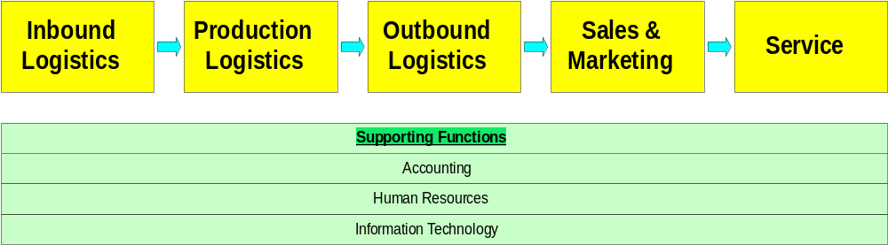
Value Chain & Supply Chain
Use a value chain or supply chain analysis when examining an industry’s depth
The emphasis of VC/SC analysis is the physical flow of goods and money
Alternate framework: inbound logistics, production logistics & sales logistics

Slide 21
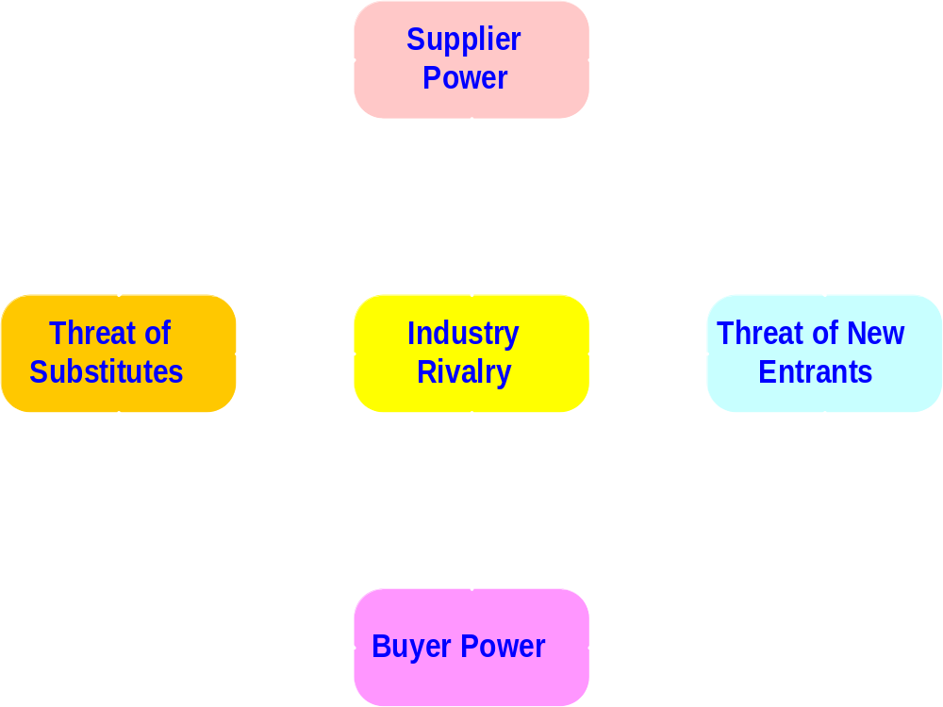
Porter’s Five Forces
A sixth force, complementary products, can be added to better describe industry dynamics
Notes:
One of the “forces” missing from Porter’s framework is complementary products – some products go hand-in-hand together, such that the demand for one impacts the demand for the other. Brandenburger and Nalebuff (?) wrote a book on essentially this point called “Co-opetition”

Slide 22
When to Use Which?
3-Cs: Customers, Competitors, Company
Value Chain/
Supply Chain
Porter’s Five Forces
A full Five Forces analysis is expansive, choose alternate frameworks whenever possible!

Slide 23
Porter’s Generic Strategies
Broad Market
Focused Market
Mass market, economies of scale dominate
Regional player, little market power
Cost Leadership
Constant cycle of innovation
Niche technology product
Feature Leadership
Generic strategies are effective as “signposts” in a full case, or as the entire analysis in a mini-case
A firm’s generic strategy can shift over time
Notes:
Treacy & Wiersma added a “third” general strategy: relationship selling

Slide 24
Firm-Level Frameworks
Firm-level frameworks are useful two-fold:
  To identify issues within a company
  To structure potential solutions to a firm’s problems
Firm-level frameworks:
  Growth-share matrix
  Marketing mix frameworks
  Core competencies
  SWOT
  Stakeholder analysis

Slide 25




Growth-Share Matrix
Question Mark
High-Growth Star
Growth Rate
Low-Growth Dog
Cash Cow
Market Share
The growth-share matrix shows the desirability of a business unit in the corporate “portfolio”
Stars are tomorrow’s cash cows
Dogs and question marks require analysis as to whether or not they should be kept (nurtured) or sold
© 1970 The Boston Consulting Group

Slide 26
Marketing Frameworks
Marketing frameworks allow you to analyze what is going on in the marketplace that may be impacting a firm
  STP – find the right market segment
  4-Ps – serve the market effectively
  5-Ms – reach the target market and influence them
Marketing frameworks ask these questions:
  Has anything changed with the customers’ tastes?
  How do customers perceive the product?
  Are there new products that have entered the marketplace?

Slide 27
STP: Finding the Correct Market
Segmenting – Identify distinctions between customers
Targeting – Identify the target group or groups
Positioning – Alter the product to appeal to the target market
STP rarely comes up in a consulting case interview, but will come up during marketing case interviews
It is not necessary to go through STP to use the core idea: is the product relevant to the marketplace? Have consumers’ tastes changed?

Slide 28
4-Ps: Marketing a Product
Product – What are the relevant product attributes?
Price – What is the product’s absolute & relative price?
Place – What are the product’s distribution channels?
Promotion – How is the product being sold/marketed?
A 4-P analysis will be required in both consulting cases and marketing cases very frequently!
The only long-run sustainable advantage in marketing is to have a superior product
New products typically have a trial “boost” to sales before the product settles in to its long-run market share

Slide 29
5-Ms: Marketing Campaigns
Mission – What is the goal of the marketing campaign?
Message – What is being said about the product?
Media – Where is the message being communicated?
Money – How much is being spent?
Measurement – How do you measure success vs. the goals?
A consulting case will almost never get to this level of detail for a “marketing-type” case – marketing interviews might
Measurement is the easiest to forget and the most critical – you must measure success somehow!

Slide 30
Core Competencies
A firm’s core competencies are the functions at which a company excels
A firm’s competitive advantage should arise out of its core competencies, but the two are not synonymous!
  Think of a competitive advantage as answering the question “what provides the firm’s major sustaining force in the market?”
  Core competencies answer the question, “How is competitive advantage maintained?”
Core competencies can be thought of as a firm’s knowledge capital – what is the sum of what the firm knows that is valuable

Slide 31
Core Competencies (cont’d)
Existing Market
New Market
How can the firm improve its position in the marketplace?
How can the firm re-deploy its competencies?
Existing Competency
What must the firm do to acquire new competencies?
What new skills are required for the markets of the future?
New Competency
Firms must constantly re-evaluate whether their core competencies remain relevant in the market
For firms to grow, they must expand their knowledge into new markets and new skills

Slide 32
SWOT is NOT Strategy
Strengths – What are the firm’s strengths?
Weaknesses – What are the firm’s weaknesses?
Opportunities – What opportunities are present in the market?
Threats – What might threaten the firm’s position in the market?
SWOT is a presentation framework – it is not an analytical framework
SWOT is best used as a short-cut framework to illustrate obvious issues in a mini-case
SWOT is generally a waste of time in a full case

Slide 33
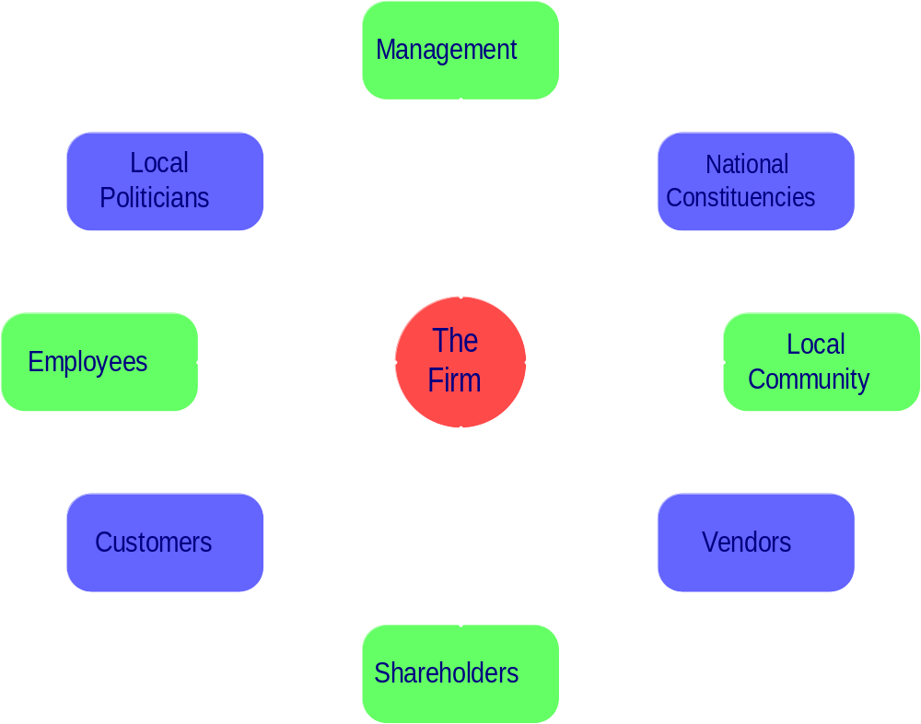
Stakeholder Analysis

Slide 34
Other Frameworks
First-year MBAs will typically not get case interviews that deal with these subjects, but they are fair game for second-year MBAs
Organization frameworks identify the steps necessary to implement changes in an organization
Political frameworks are used to develop strategies for dealing with organizations that are not profit motivated
Macroeconomic frameworks are useful if you must work through a tough global case
“The Government of Costa Rica wants you to define & implement an industrial policy for them…”

Slide 35
McKinsey’s 7-S Model
Strategy – What is the firm trying to accomplish?
Structure – What organization form best suits the firm’s goals?
Staffing – What type of staff does the firm require?
Style – What management style does the firm utilize?
Skills – Does the firm’s employees have the skills required?
Systems – What measurement systems must be put in place?
Shared Values – What is the firm’s culture like?
This is an extremely important framework, but will almost never show-up in a case interview

Slide 36
Kotter’s Change Management Model
Vision – Create a compelling vision of the future
Urgency – Create a sense that action must occur soon
Leadership – Ensure that there is clear leadership for change
Coalition – Create a coalition to spread change throughout the firm
Empowerment – Empower others to facilitate change
Communicate – Communicate the needs & actions for change
Success – Create short-term successes to sustain momentum
Consolidate – Consolidate improvements & identify future changes

Slide 37
Political Strategy
Identify Participant Stakes & Capabilities
Reframe the Issue
Develop a Coalition
Adjust Issue Visibility
Develop Grassroots Support
Stakeholder analysis is key – you must identify where each participant falls on the issue and what they can bring to bear

Slide 38
Macroeconomics
GDP = C + I + G + X
GDP is the aggregate of:
  Consumer spending
  Business investment
  Government spending (not transfer payments)
  Net exports
Net exports is the most volatile component of national income and is the easiest one for most governments to target for manipulation
  Cases with international components typically include foreign exchange (FX) issues – watch out for them!

Slide 39
Competitive Responses
Analyze a company’s options based upon the threat level and possible resources brought to bear
  Ad hoc matrices work well for this
  Be careful about making assumptions early – if you assume a threat level early, this will be where it comes back to haunt you
Many business decisions do not have good outcomes, only less bad ones
  Look for responses that have natural stopping points
  Marketing can be used to send competitors signals
  Use the Prisoner’s Dilemma as a starting point for understanding your possibilities

Slide 40
Matrices
We have already demonstrated three key matrices:
  Porter’s Generic Strategies
  BCG Growth-Share Matrix
  Hamel/Prahalad Core Competency Matrix
Matrices are an excellent way to illustrate a small number of potential scenarios or concepts
  High impact vs. low impact
  High market share vs. low market share
  Broad market reach vs. limited market reach

Slide 41
Sample Matrices
“You are the head of R&D for a large pharma company, and a new process has been created as a result of the work done to sequence the human genome…”
High Impact
Low Impact
Crash program to incorporate new technology into existing processes
Evaluate relevance and switching costs
Core Business
Look for possible disposition or outsourcing opportunities
Watch to see if the technology becomes relevant
Non-Core Business

Slide 42
Sample Matrices (cont’d)
“You are a brand manager for P&G in the Health & Beauty Aids category, and a competitor just introduced a new toothpaste that is gaining market share…”
High Market Share
Low Market Share
Identify if share loss is due to trials or switching; re-do marketing mix
Examine product’s benefits; identify potential line extension?
Same Target Market
Re-examine market segmentation & potentially introduce competing product
Ignore it?
Different Target Market

Slide 43
Prisoner’s Dilemma
Prisoner’s Dilemma is a game theory concept that tells a tremendous story: why do sub-optimal outcomes occur?
In a single-period model, the prisoners always defect
Prisoner 1
Don’t Confess
Confess
Prisoner 1: 3
Prisoner 2: 3
Prisoner 1: 4
Prisoner 2: -5
Don’t Confess
Prisoner 2
Prisoner 1: -5
Prisoner 2: 4
Player 1: -3
Player 2: -3
Confess
All business problems are multi-period games – you should always look for a sustainable answer, not the neutron bomb!

Slide 44
How to Choose the Right Framework
Choosing the right framework is mostly a matter of practice
  Know the core frameworks cold
  Practice mixing and matching frameworks with different types of cases
Pay attention to the problem description
  Pick through the noise to find the critical issues
  Do not get lost in the details – all cases are essentially generic
  Once the critical issue is identified, the proper framework will generally select itself

Slide 45
Where to Find Additional Help
Consulting club member (talk to Dymph!)
Work with each other!
Wetfeet’s Guide to Case Interviewing
Company web sites
Your professors

Slide 46
Suggested Reading List
Michael Porter – On Competition
C. K. Prahalad & Gary Hamel – Competing for the Future
Hammer & Champy – Reengineering the Corporation
O’Shea & Madigan – Dangerous Company
Mickelthwait & Wooldridge – The Witch Doctors

Slide 47
Re-Cap
You should now know:
What a case interview is and is not
How to manage a case interview
What some of the major frameworks are for “solving” a case
How to look for appropriate competitive responses
Where to go to look to find additional help with case interviewing

